Slide 1
The Transport Layer

Slide 2
Services Provided to the Upper Layers
Elements of transport protocol
Addressing
Connection Establishment
Connection Release

Slide 3
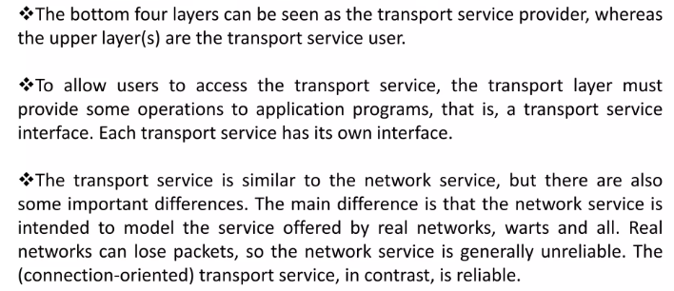
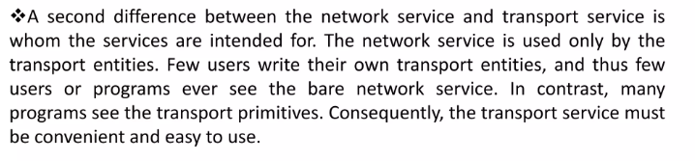
Services Provided to the Upper Layers

Slide 4
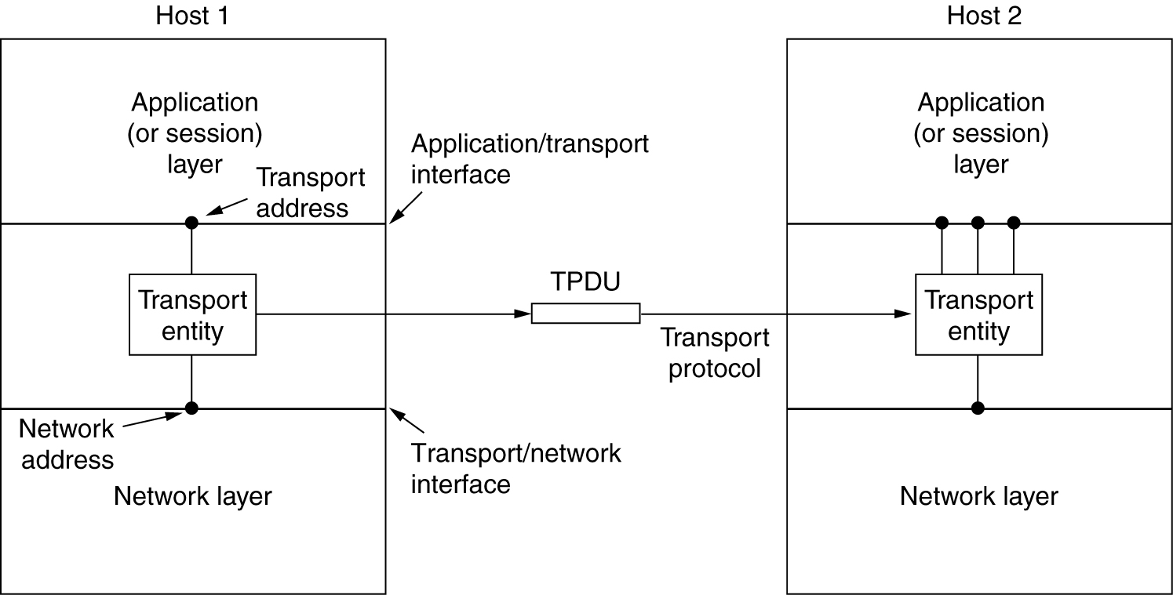
Services Provided to the Upper Layers
The network, transport, and application layers.

Slide 5
Transport layer
1. The network layer exists on end hosts and routers in the network. The end-user cannot control what is in the network. So the end-user establishes another layer, only at end hosts, to provide a transport service that is more reliable than the underlying network service.
2. While the network layer deals with only a few transport entities, the transport layer allows several concurrent applications to use the transport service.
3. It provides a common interface to application writers, regardless of the underlying network layer. In essence, an application writer can write code once using the transport layer primitive and use it on different networks (but with the same transport layer).

Slide 6
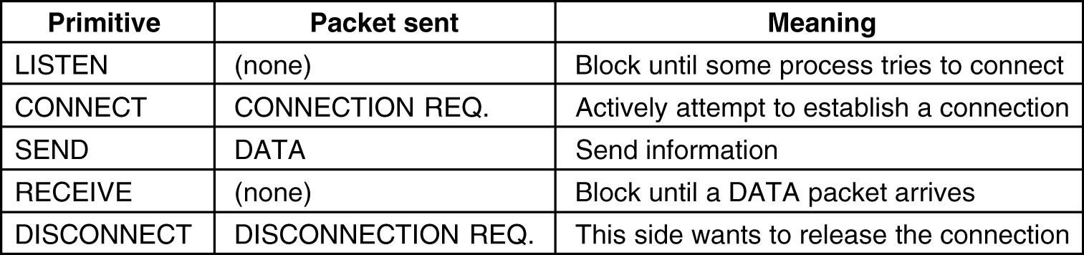
Transport Service Primitives
The primitives for a simple transport service.

Slide 7
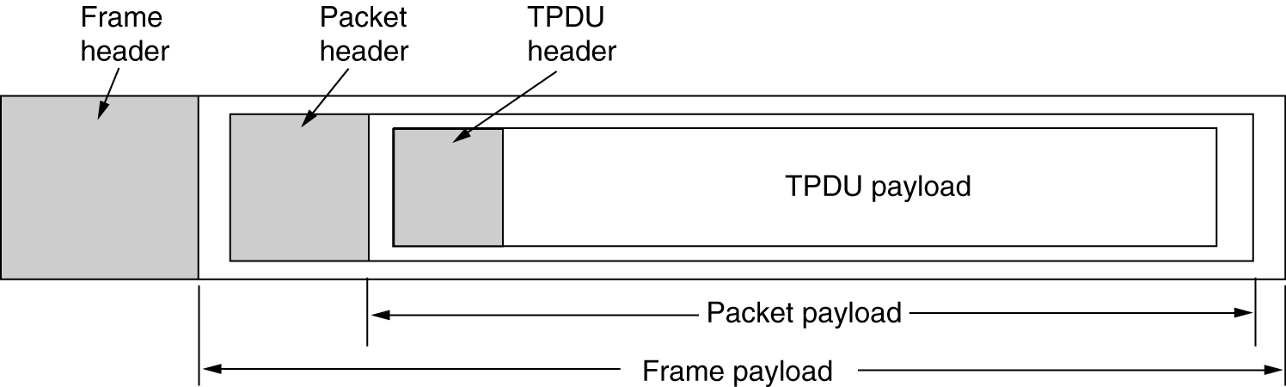
Transport Service Primitives
The nesting of TPDUs, packets, and frames.

Slide 8
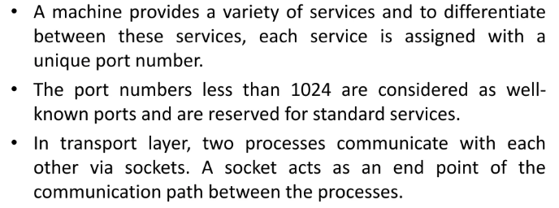
Transport Service Primitives

Slide 9
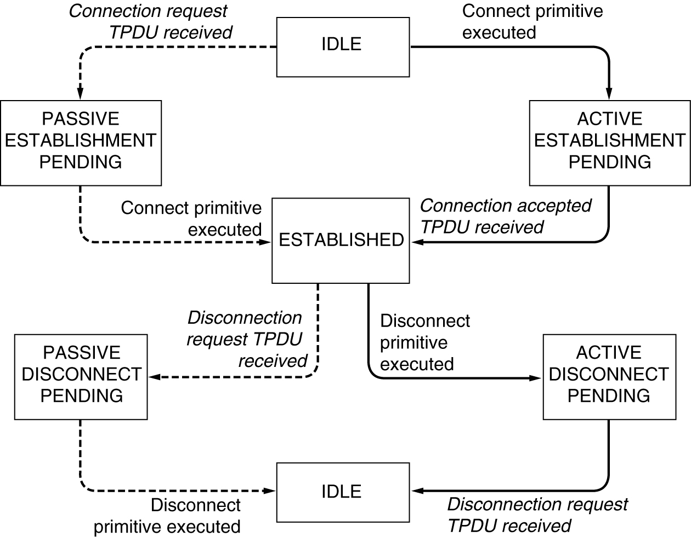
Transport Service Primitives
A state diagram for a simple connection management scheme. Transitions labelled in italics are caused by packet arrivals. The solid lines show the client's state sequence. The dashed lines show the server's state sequence.

Slide 10
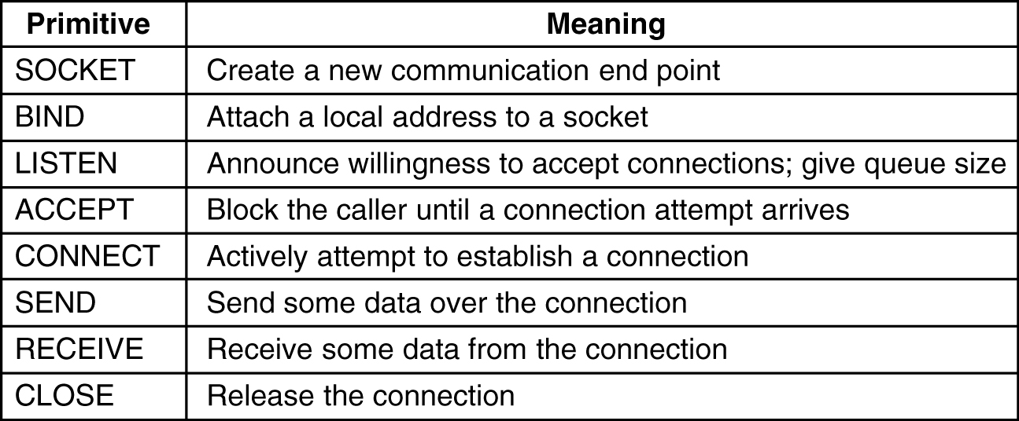
Berkeley Sockets
The socket primitives for TCP.

Slide 11
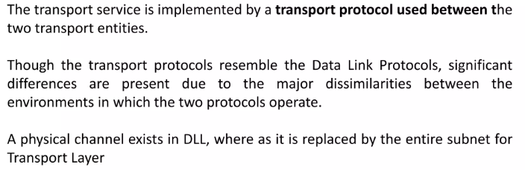
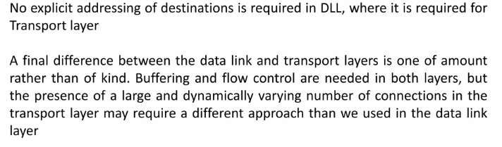
Elements of Transport Protocol

Slide 12
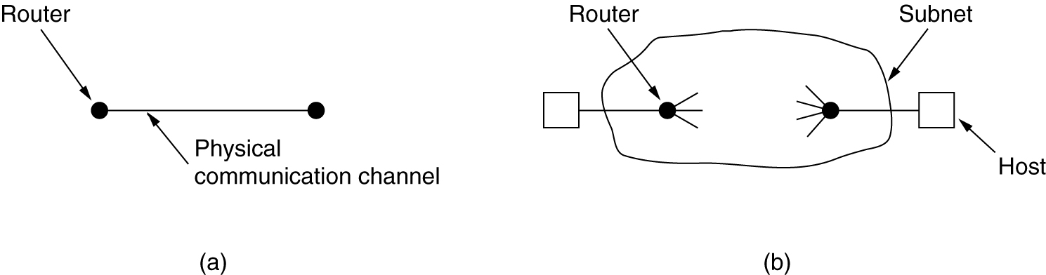
Transport Protocol
(a) Environment of the data link layer.
(b) Environment of the transport layer.
Both data link layer and transport layer do error control, flow control, sequencing. The differences are:
1. Storage capacity in subnet. Frames must arrive sequentially, TPDUs can arrive in any sequence.
2. Frames are delivered to hosts, TPDUs need to be delivered to users, so per user addressing and flow control within the hosts is necessary.

Slide 13
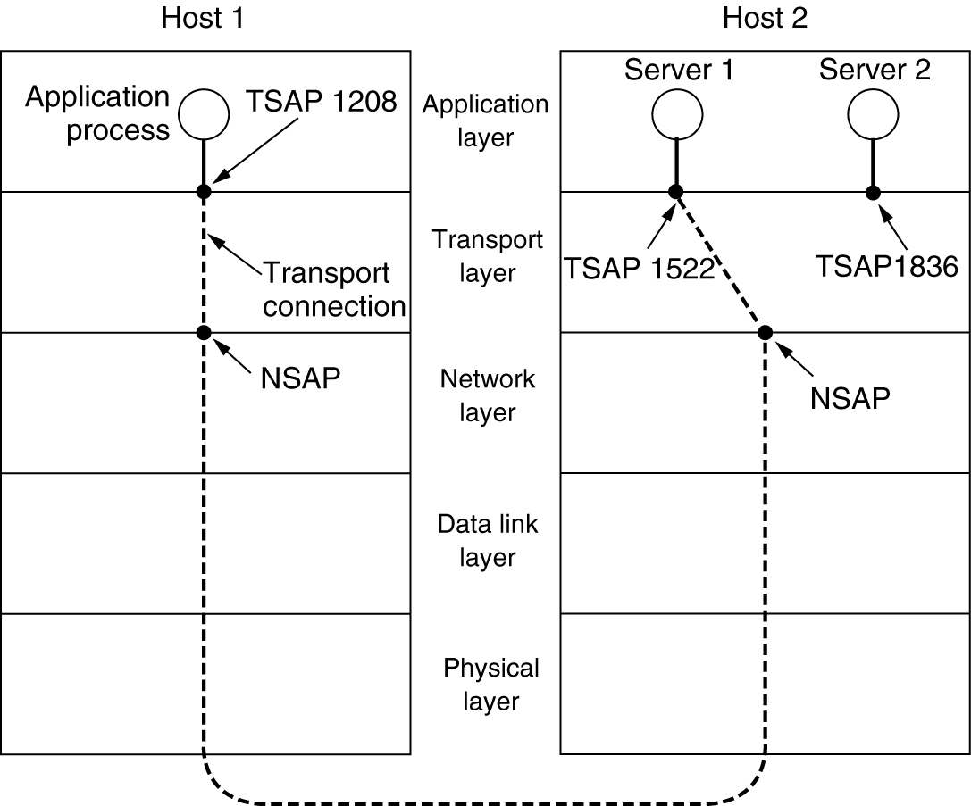
Addressing
TSAPs (Transport Service Access Point) , NSAPs (Network SAP).
TCP calls TSAP s ... ports
ATM calls TSAPs ... AAL-SAP

Slide 14
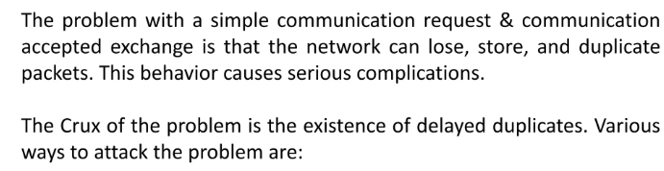
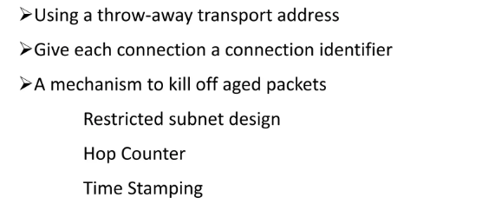
Connection Establishment

Slide 15
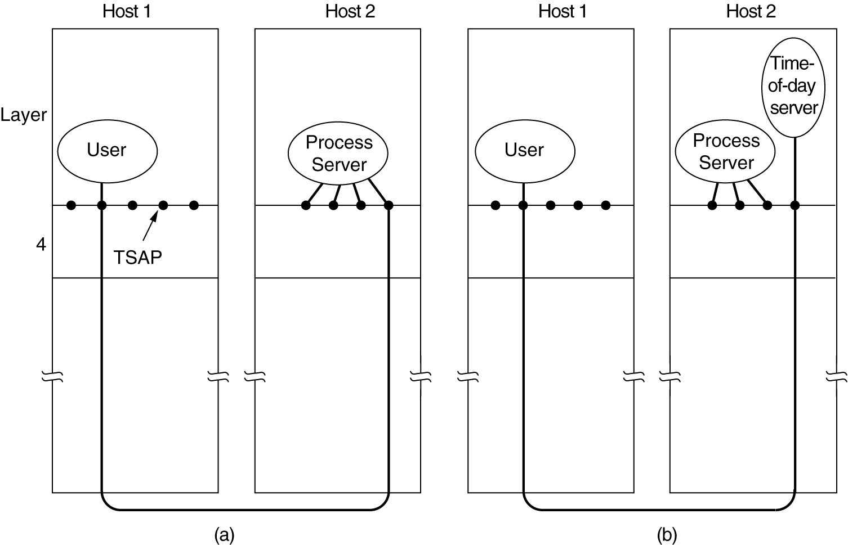
Connection Establishment
How a user process in host 1 establishes a connection with a time-of-day server in host 2.

Slide 16
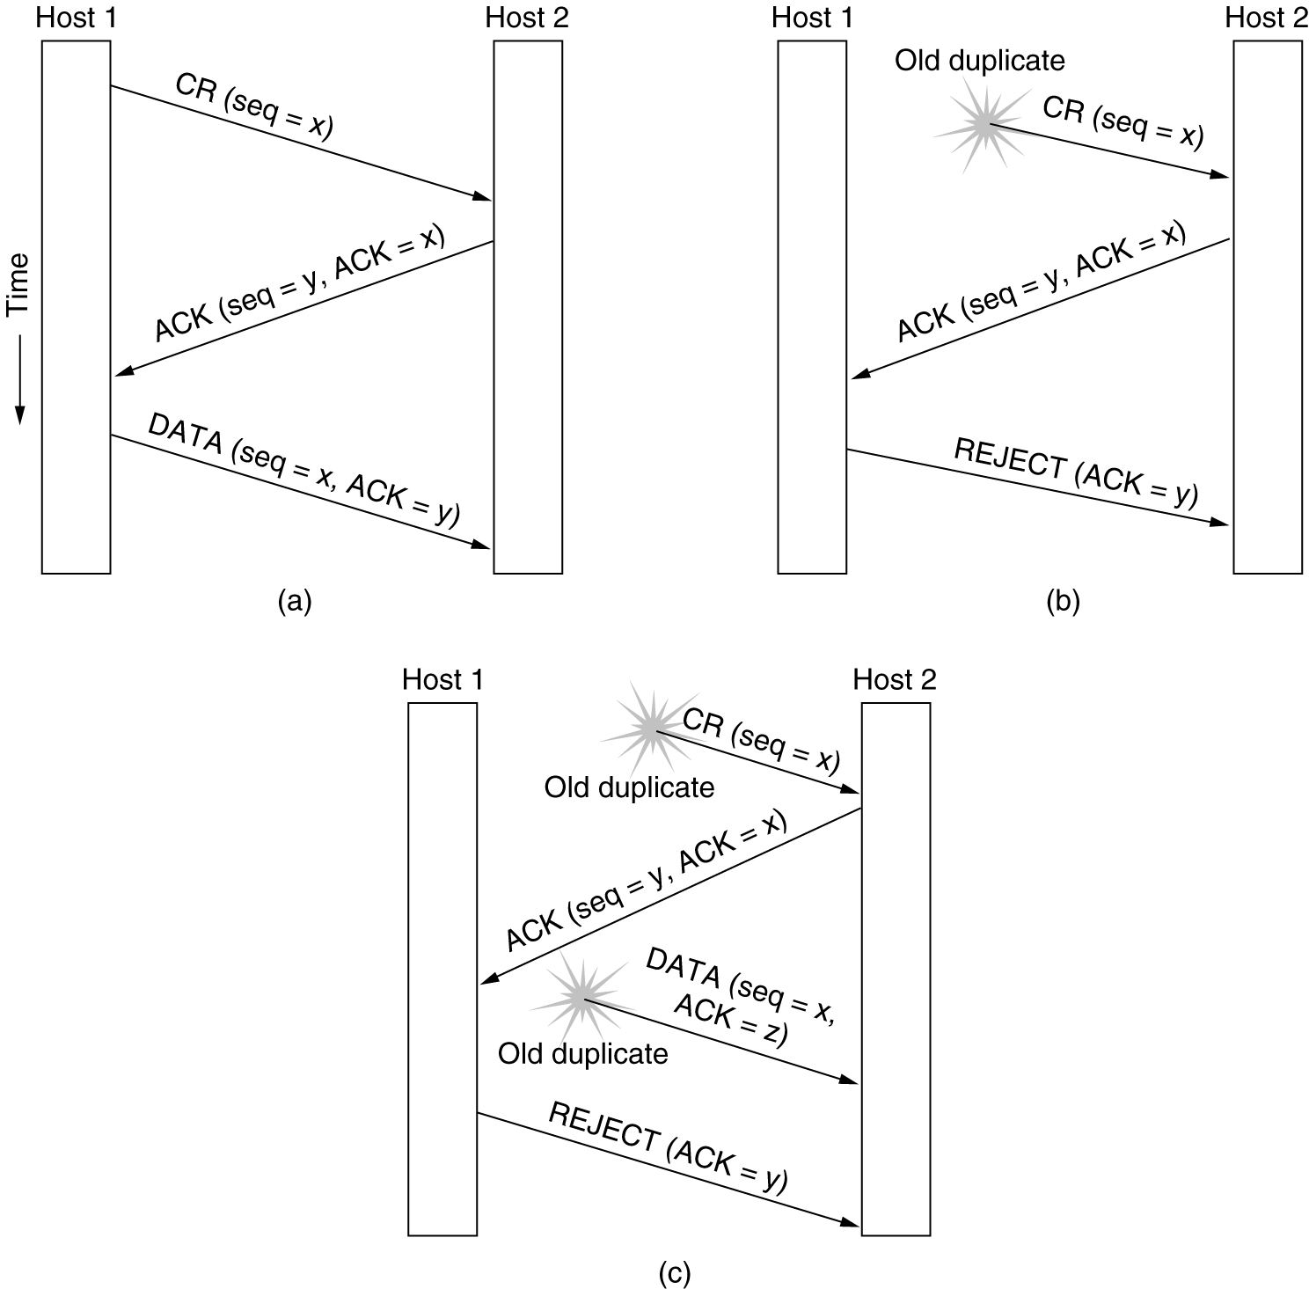
Connection Establishment
Three protocol scenarios for establishing a connection using a three-way handshake. CR denotes CONNECTION REQUEST.
(a) Normal operation,
(b) Old CONNECTION REQUEST appearing out of nowhere.
(c) Duplicate CONNECTION REQUEST and duplicate ACK.

Slide 17
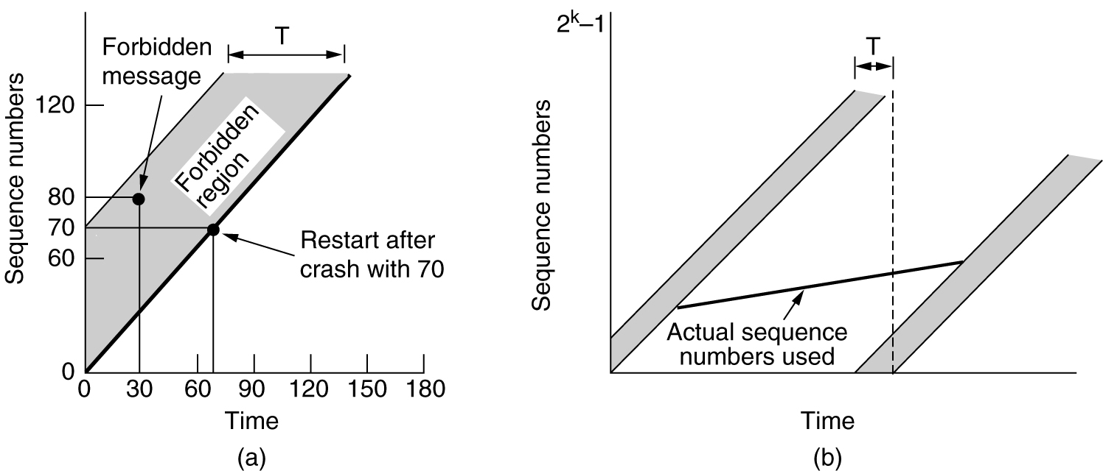
Connection Establishment
(a) TPDUs may not enter the forbidden region.
(b) The resynchronization problem.

Slide 18
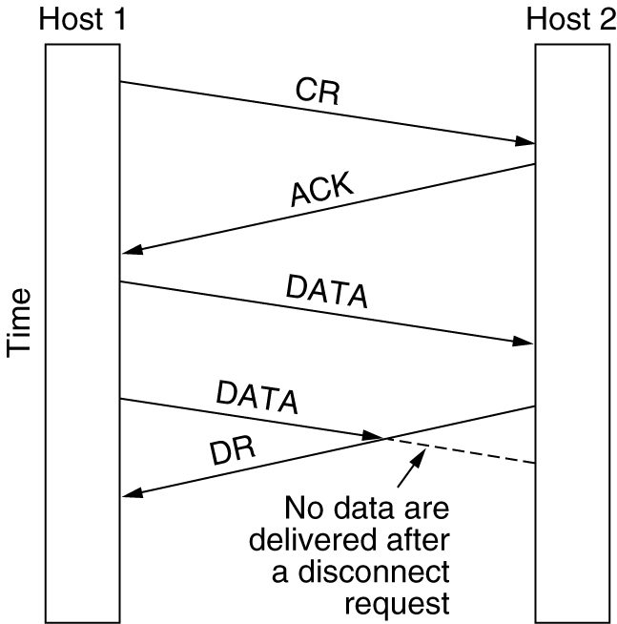
Connection Release
Abrupt disconnection with loss of data.

Slide 19
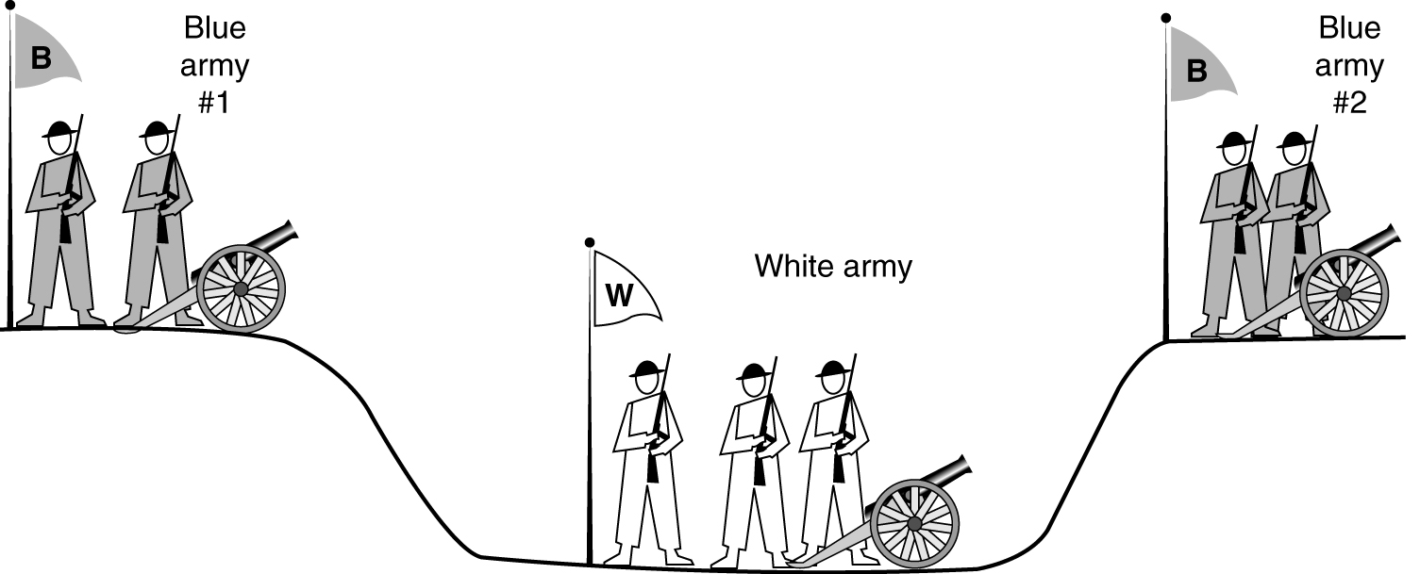
Connection Release
The two-army problem.

Slide 20
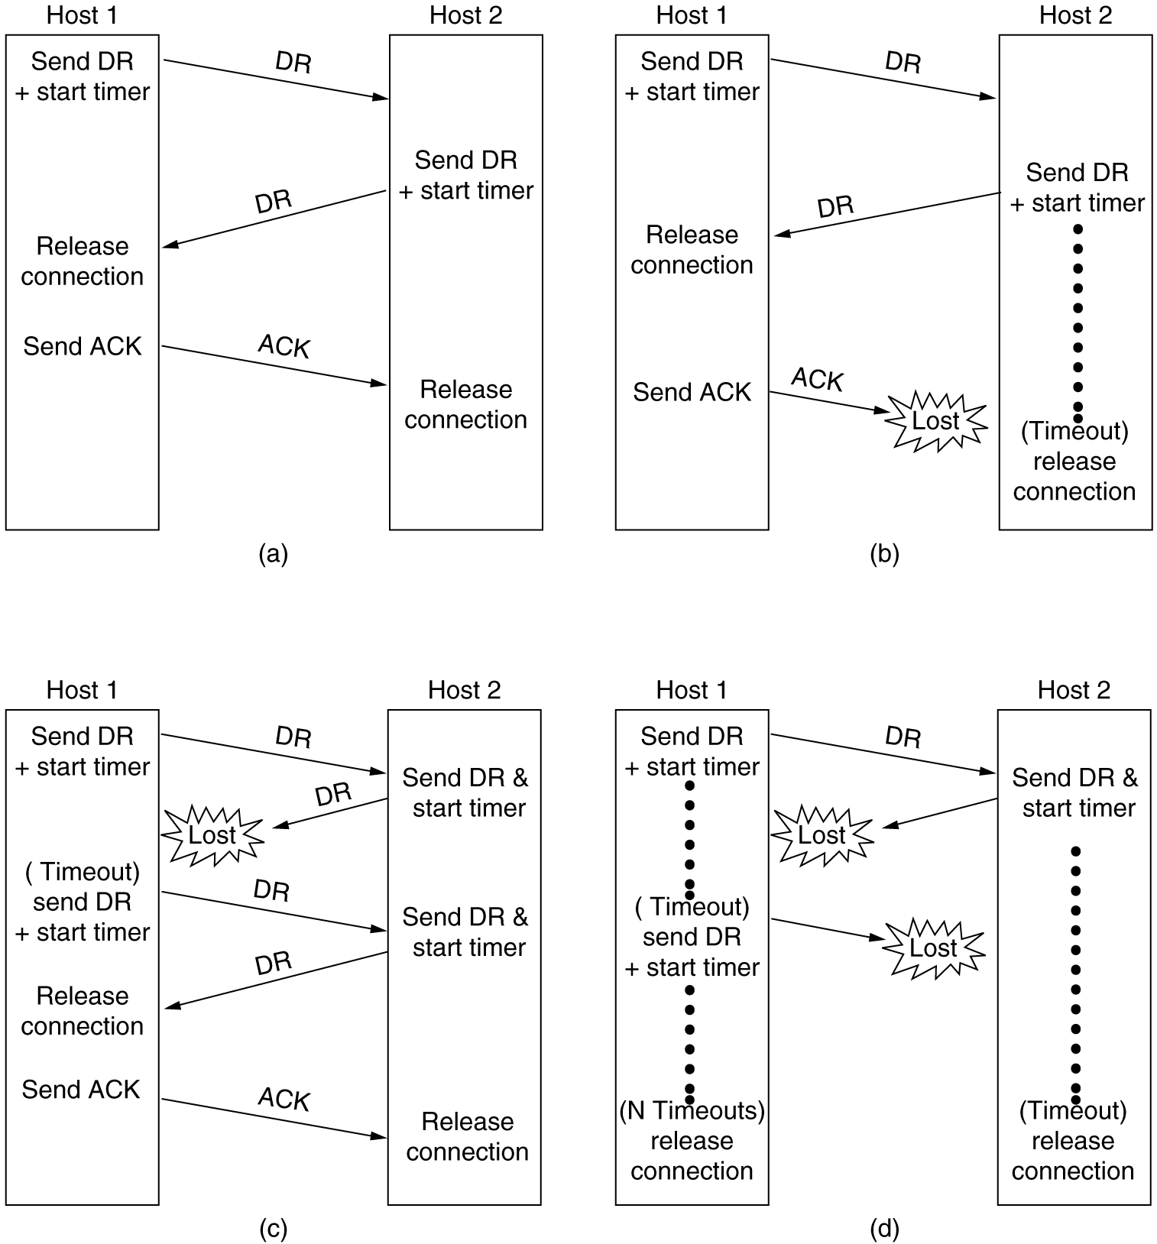
Connection Release
6-14, a, b
Four protocol scenarios for releasing a connection. (a) Normal case of a three-way handshake. (b) final ACK lost.

Slide 21
Connection Release
6-14, c,d
(c) Response lost. (d) Response lost and subsequent DRs lost.

